Slide 1
Parameter estimation with respect to industrial motor duty: Dominant parameters grouping and determination algorithm
09.01.2021
2244 METU-arçelik
Serhat Özküçük

Slide 2
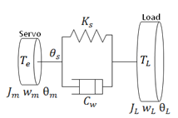
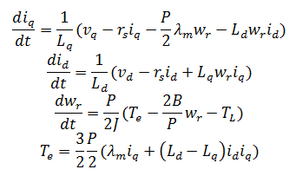
System Dynamics Based Parameter Estimation
MRAS
OBSERVER
ESTIMATOR
PREDICTOR
FREQ. BASED
ADAPTIVE
NUMERICAL/ITERATIVE
AI BASED
FILTER BASED
EXCITATION BASED
…
When and how often will parameter estimation and tune be made?
Are all parameters (electrical & mechanical) deviating significantly ?
What extent does the processing power change in higher order (more than two mass) systems?

Slide 3
More info about system behaviour ?
We know
We don’t know
Motor Type and Dynamics
Load Model
Control Structure
Limitations (electrical & mechanical)
Working Cycle
Motor Duty Categorization
Disturbance Significances
Exact location of disturbance source on the drive train
Mechanical Constraints details
Mechanical parameter deviation
Contact – Bounding Numbers
Multi motor-load structure
We can done
Parameter estimation
Disturbance detection
Vibration suppression
Friction compensation
Tuning

Slide 4
Motor Duty Types
Continuous running duty (type S1)
Short-time duty (type S2)
Periodic duty (type S3-S8)
Intermittent periodic duty (Type S3)
Intermittent periodic duty with starting (Type S4)
Intermittent periodic duty with electric braking (Type S5)
Continuous-operation periodic duty (Type S6)
Continuous-operation periodic duty with electric braking (Type S7)
Continuous-operation periodic duty with related load / speed (Type S8)
Non-periodic duty (type S9)
Duty with discrete constant loads (and speeds) – type S10
Duty for equivalent loading

Slide 5
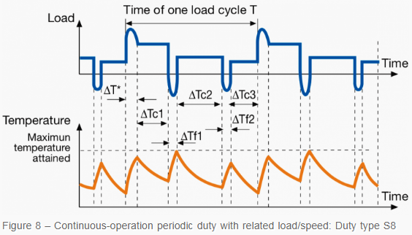
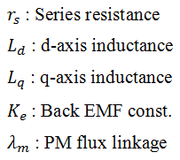
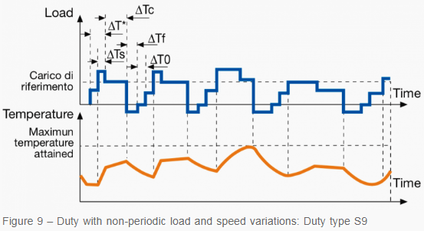
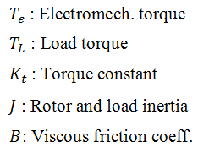
Duty-Parameter relation
Examples: Duty types
Electrical Parameters
Mechanical Parameters

Slide 6
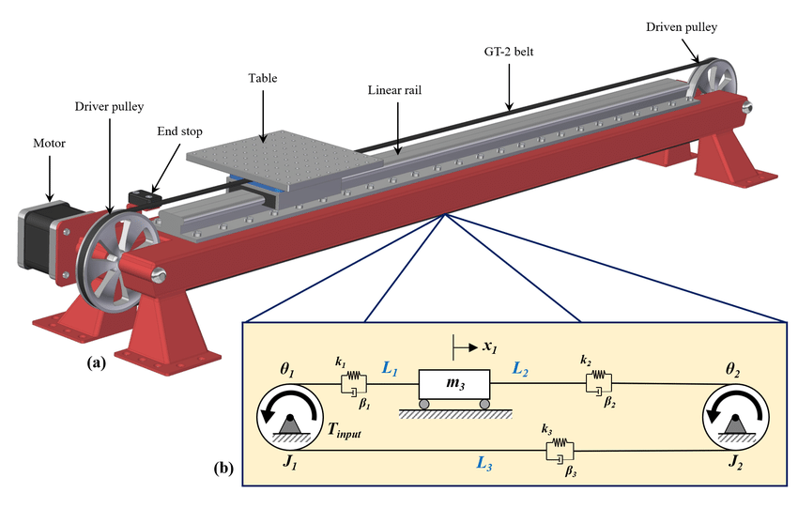
Transmission
Load
pulley-belt
lead-screw
rack-pinion
belt-wheel
gear-wheel
direct drive
linear
rotational
contour
custom
motion
PMSM Servo Motor
Coupler

Slide 7
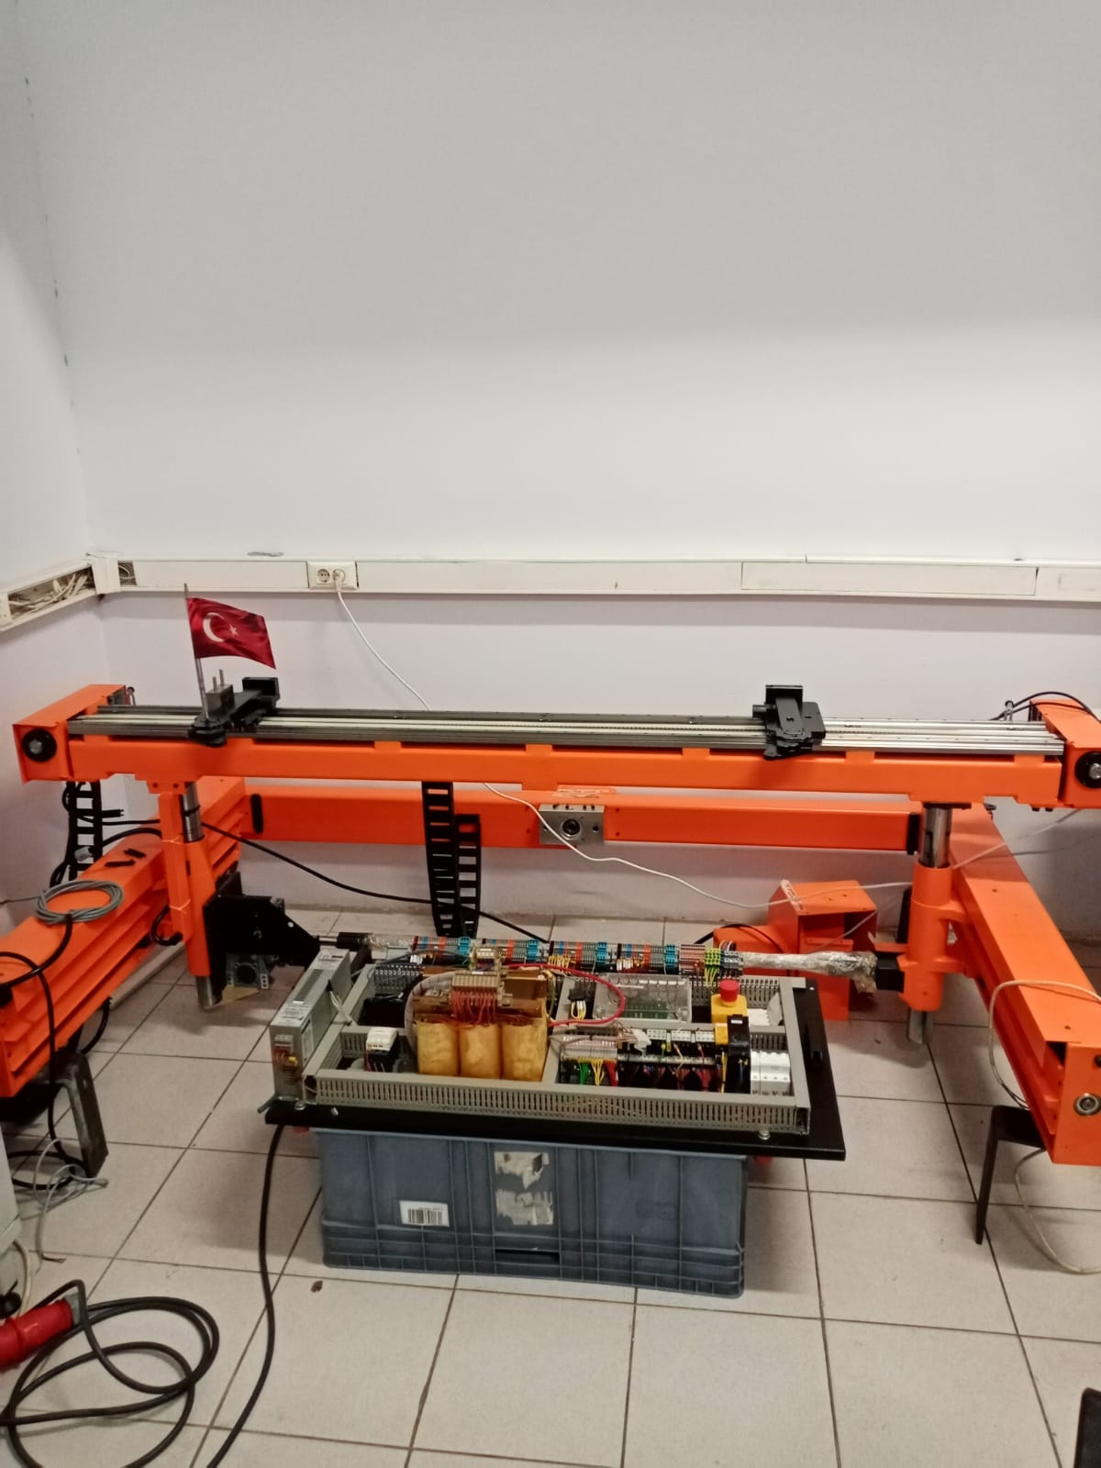
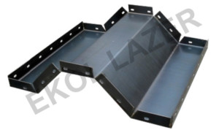
Ermaksan Press Brake (abkant büküm)
Servo 1
Press 1
Press 2
Servo 2
Rail-Belt
motion directions
Power + Control

Slide 8
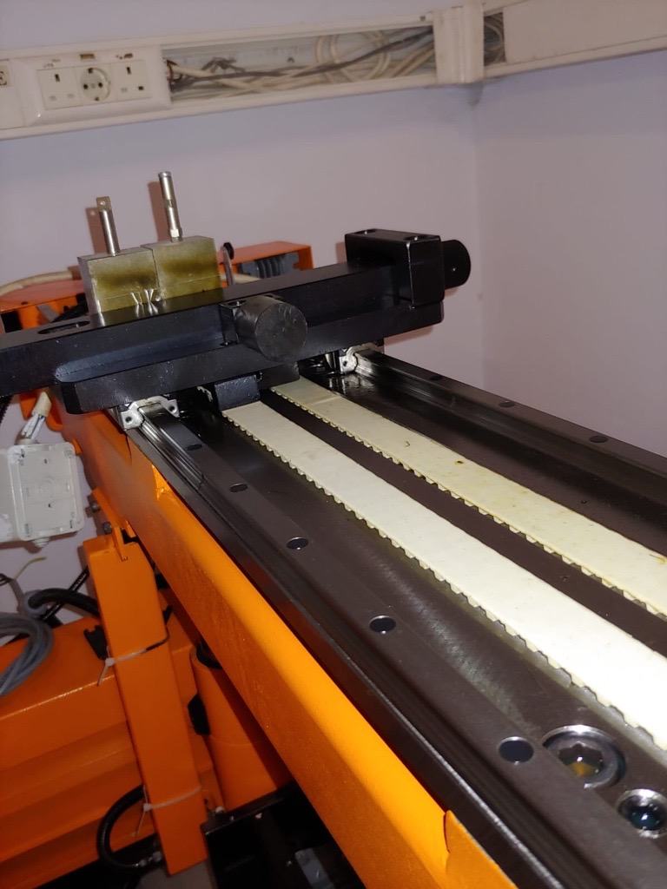
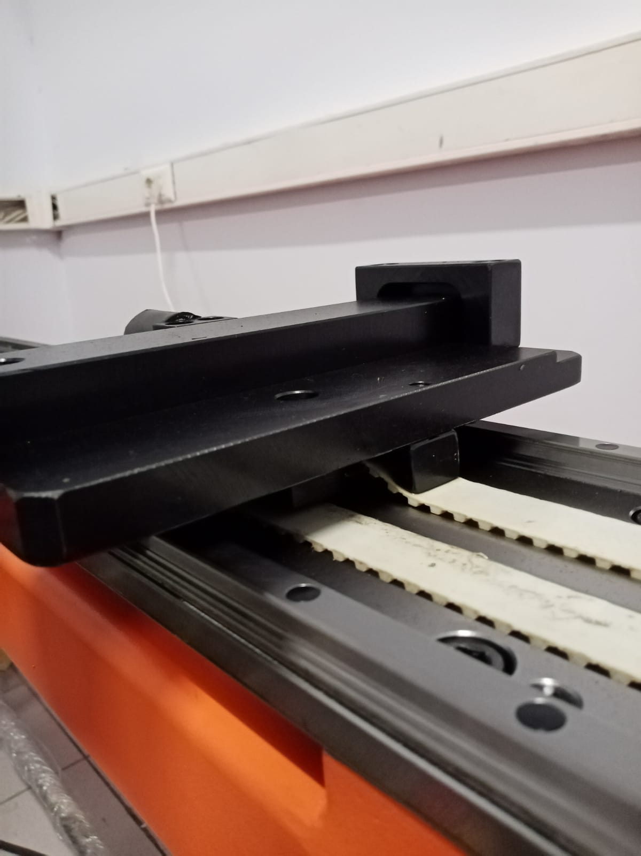
Rail-Belt Drive

Slide 9
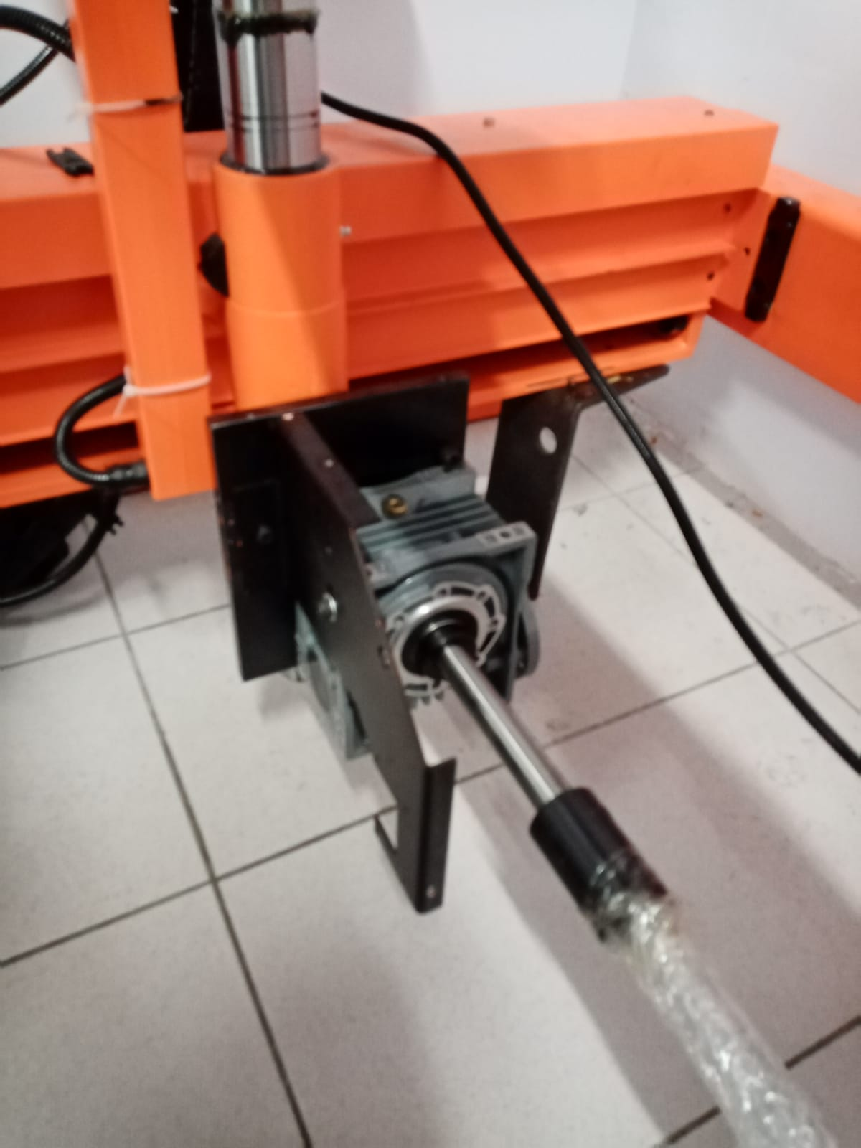
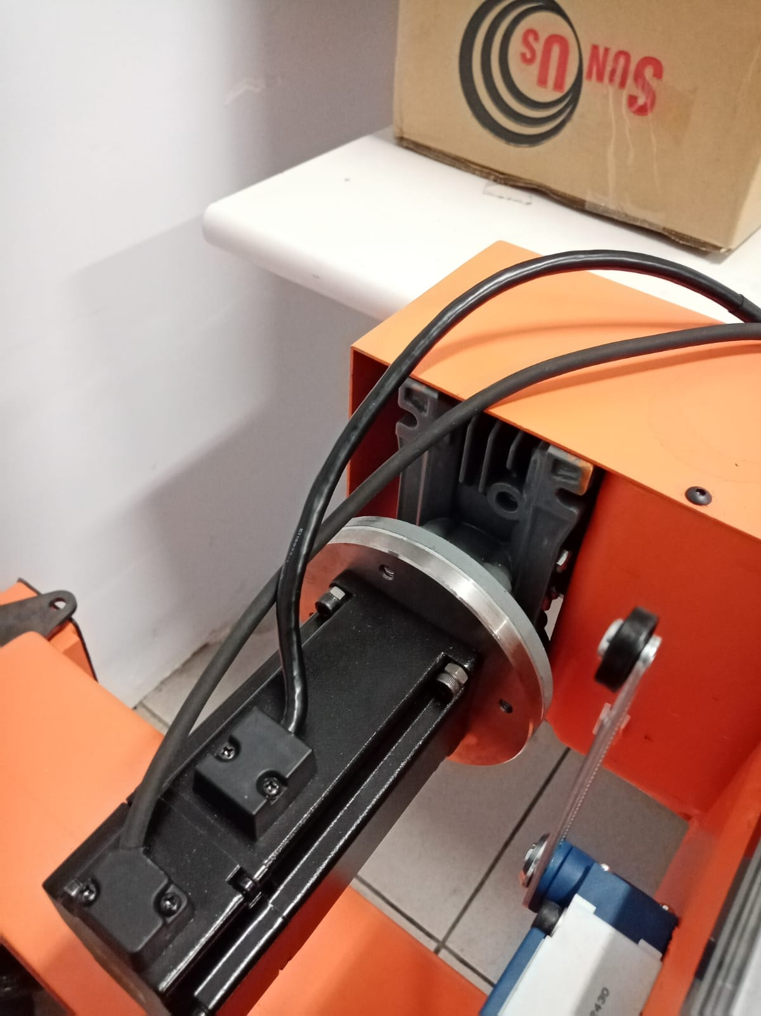
Multiple Servo Drive

